Slide 1

Transfer of Research Assets between FAIRDOM SEEKs BioHackathon 2018 - Paris
Stuart Owen: University of Manchester
https://fair-dom.org
https://seek4science.org

Slide 2
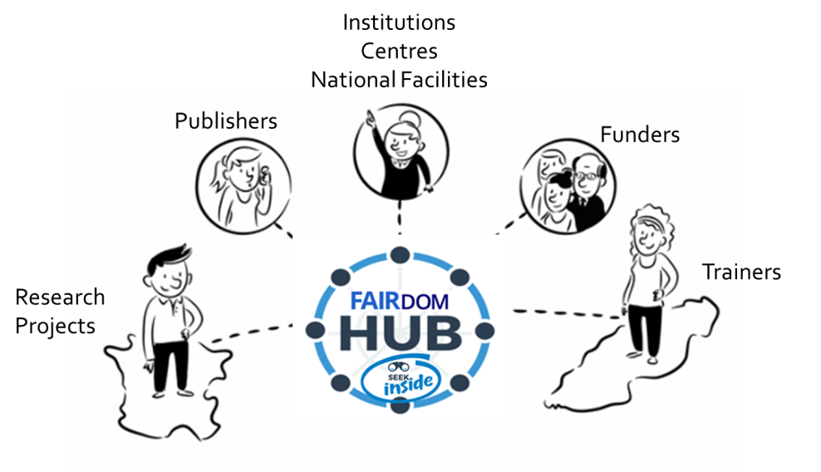

Background … FAIRDOM
2008
Findable
Accessible
Interoperable
Reusable
Data
Operations
Models
2010
2012
2014
Making the most of System and Synthetic Biology Projects’ Assets
Data – Models – SOPs – Workflows – Samples – Publications – Process - Documents – People - Expertise
2018
modellers
experimentalists
Data and Model Managements for all scales of projects
Notes:
On overview of FAIRDOM, and then a description about SEEK. Explain the API and Research Objects

Slide 3



Background … SEEK
2008
Project
Commons
2010
2012
2014
2016
Project
Commons
Platform
2018
Self managed spaces
Yellow pages
Single entry point over external systems
2020
Notes:
Setup a special repo linked to Docker Hub
Rick Jansen

Slide 4
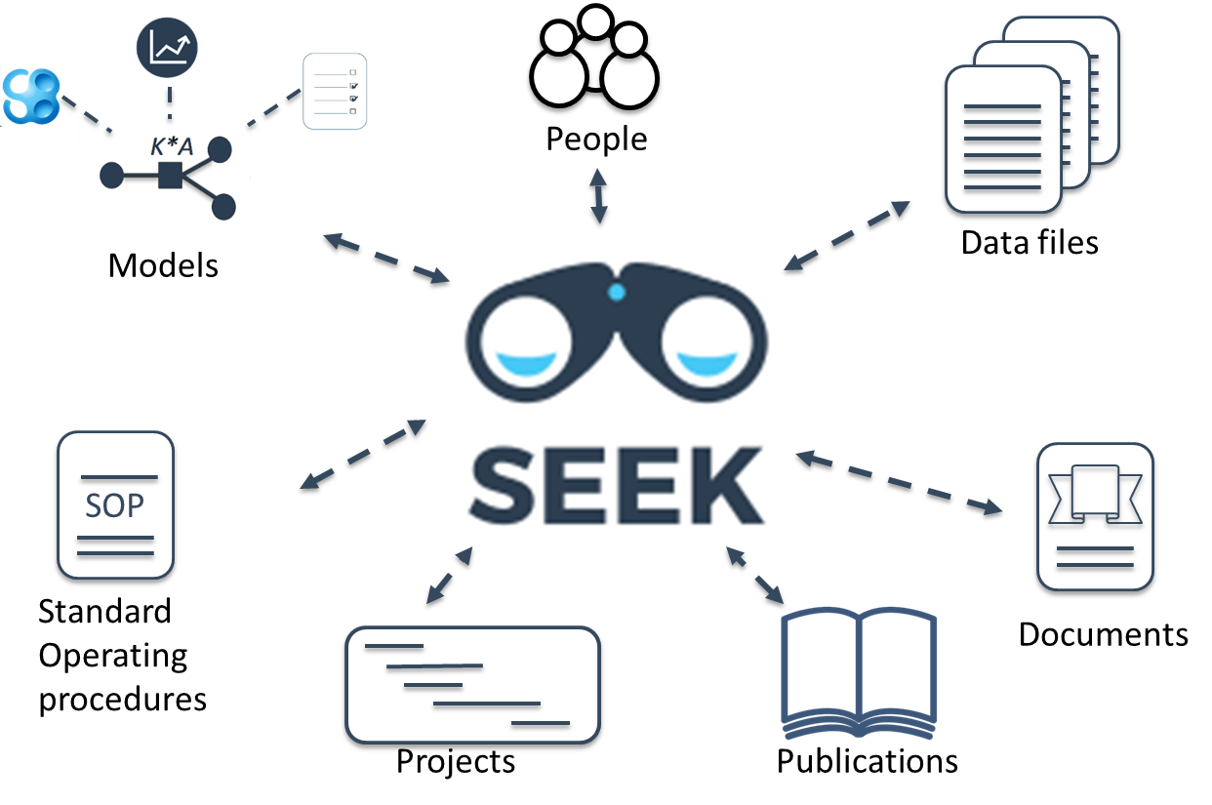
Background … SEEK
2008
2010
2012
2014
2016
2018
2020
Notes:
Basic transfer from one SEEK to another. Only aiming for a simple proof of concept. This could be done via the API or Research Objects.
Aware it may be too ambitious and people dropped out.
Also mention Galaxy and Bioschema.

Slide 5
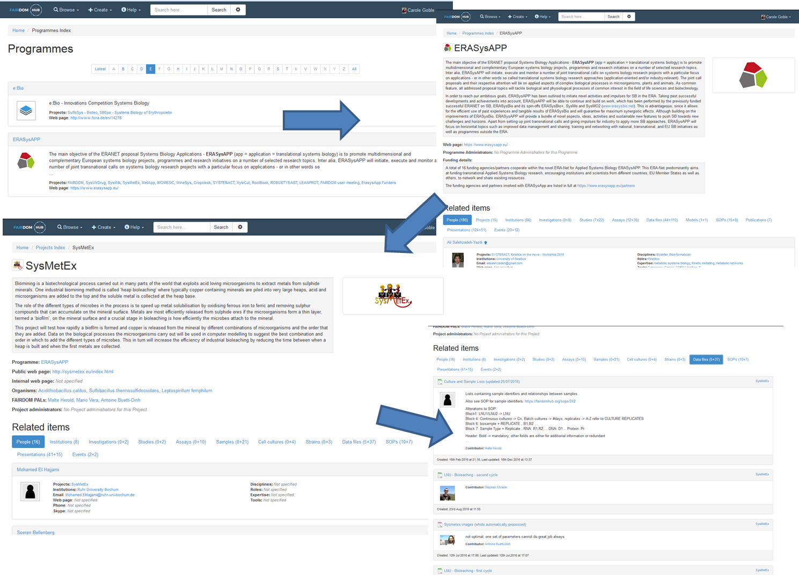
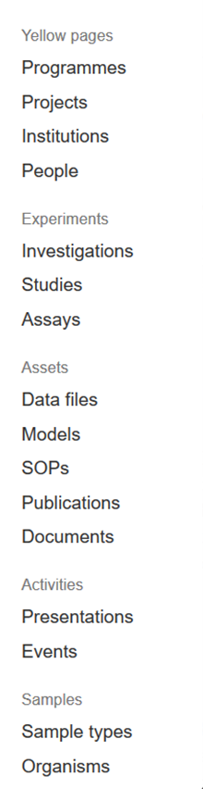
Programme
Project
Project Management
Investigation
Notes:
New asset type to support Documents
General Documents that don’t fit to SOPs or Data – such as project reports or minutes
Can be linked to Assays
Future plans to categorise and be included in JERM ontology (directly or with mappings to a suitable existing ontology)

Slide 6
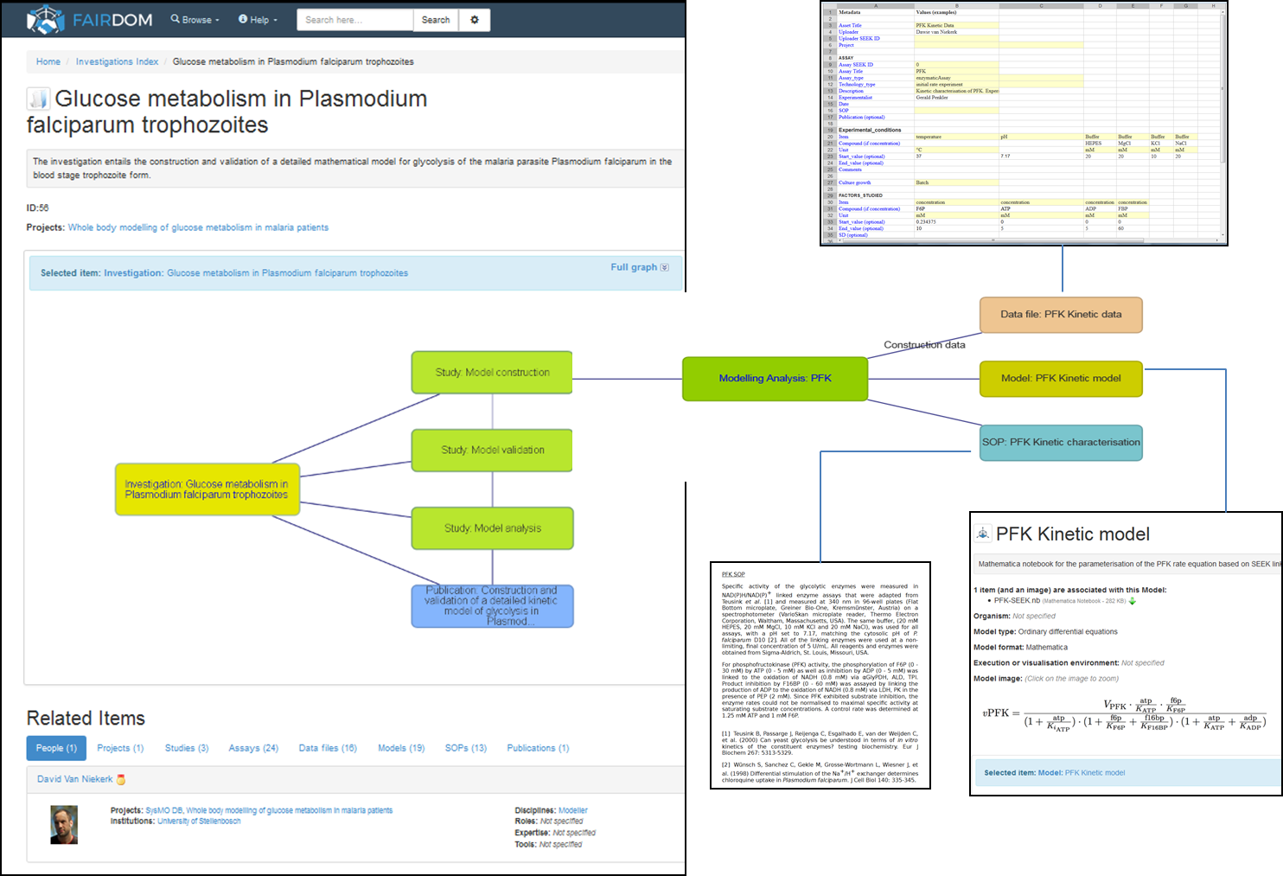
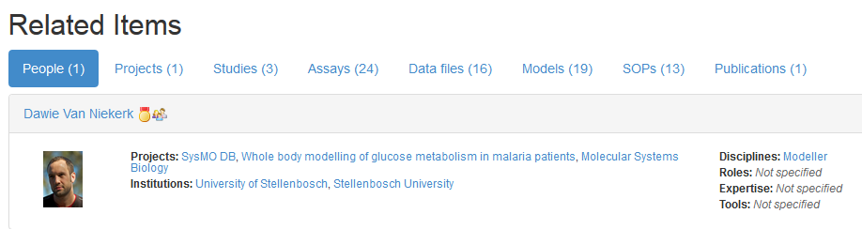
Data
Study
Analysis
Model
(Assay)
SOP
Investigation
https://fairdomhub.org/investigations/56

Slide 7
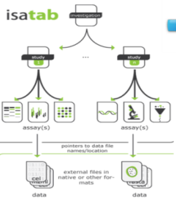
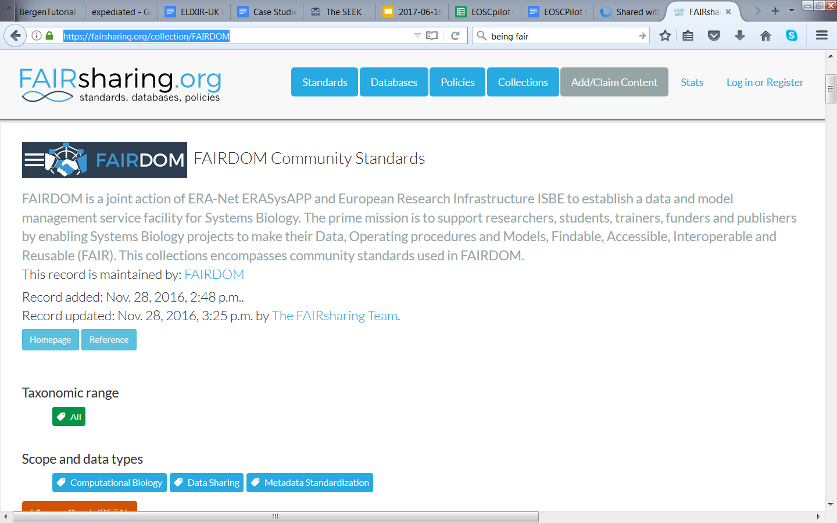
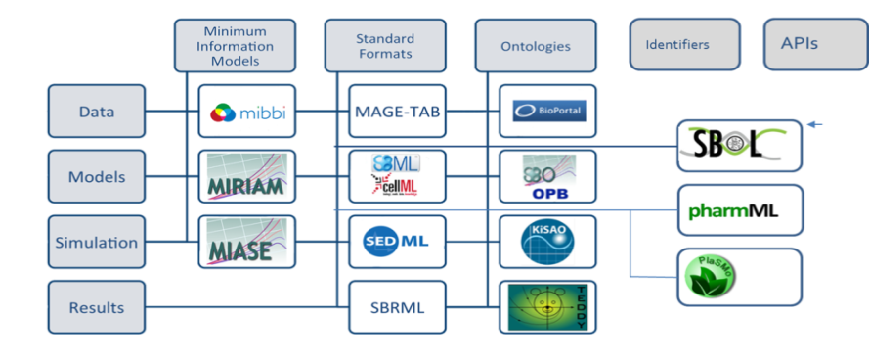
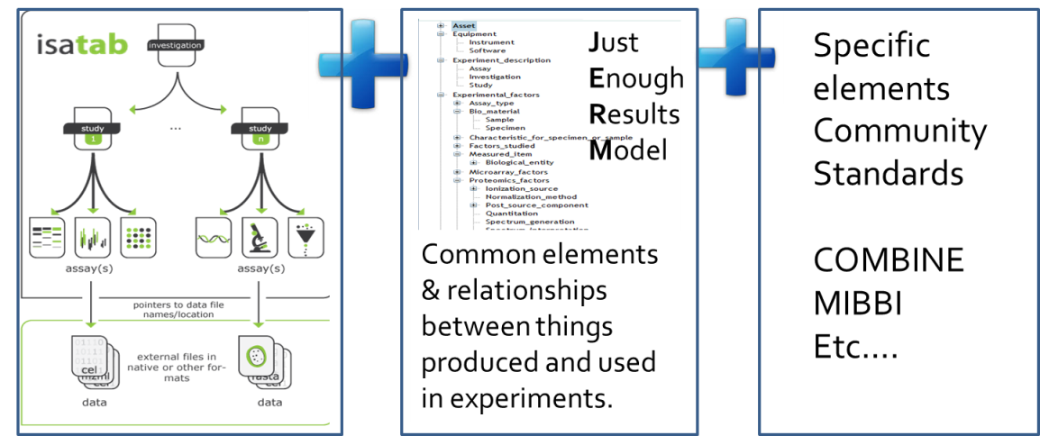
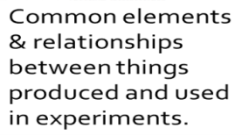
Dissem-
inate
Organise
Manage
Metadata
Share
Standards based
JERM v2
Sample model
RDF – Linked Data
Bioschemas.org, DCAT
Investigation
Studies
Assay/Analysis
Entry
level
Entry
level
Record level: subject thematic standards
Notes:
JERM version 2 ontology
Dedicated website: https://jermontology.org
Updated to remove SysMO specific terms and reflect new sample model
Mappings added for Dublin Core and Prov/Pav
RDF updated and extended, along with improvements to SPARQL store integration
https://sparql.fairdomhub.org/sparql

Slide 8
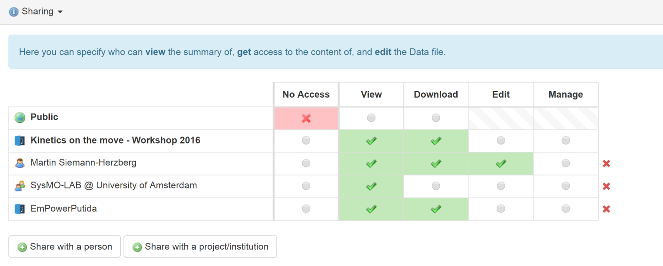
Selective Sharing
Dissem-
inate
Organise
Manage
Share

Slide 9
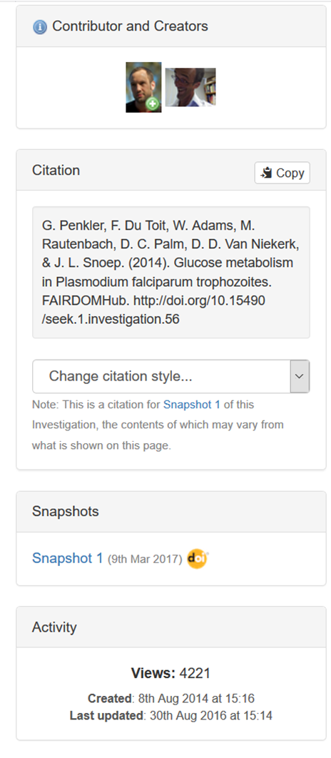






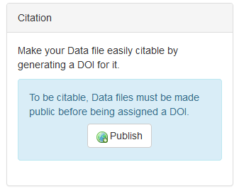

Snapshot
Publishing
Dissem-
inate
Organise
Manage
Share
Licenses
Snapshots for ISA
DOI improvements
Notes:
Licenses: The “R” in “FAIR”
Tied to opendefinition.org
Finer grained snapshots for publication
Snapshots are packages frozen in time, based on Research Objects, along with a DOI
Now available for Assays and Studies, as well as Investigations
Easier and more intuitive publishing with DOI generation

Slide 10



Motivation
Groups commonly would like push research outcomes from a locally managed SEEK to the FAIRDOMHub for publishing and long term storage.
Project Lab
Project Lab
Project Lab
Notes:
Explain about local SEEKs, and a need to push to the FAIRDOMHub

Slide 11
Hackathon Goals
2008
Transfer of items from one SEEK to another SEEK
One direction only
Initiated from the ‘origin’ SEEK
Simple case, proof of concept
Aim for transferring a single Assay with some assets attached.
Re-usable and/or adaptable for other destinations
Get a clearer idea of design decisions and what the unexpected difficulties may be
2020
Notes:
Basic transfer from one SEEK to another. Only aiming for a simple proof of concept. This could be done via the API or Research Objects.
Aware it may be too ambitious and people dropped out.
Also mention Galaxy and Bioschema.

Slide 12

Hackathon Side Goals
2008
2020
Notes:
Basic transfer from one SEEK to another. Only aiming for a simple proof of concept. This could be done via the API or Research Objects.
Aware it may be too ambitious and people dropped out.
Also mention Galaxy and Bioschema.

Slide 13







Technology
2008
2010
2012
2014
2016
2018
2020
Notes:
Explain Ruby, JSON, Ruby on Rails, Docker

Slide 14
Hack Organisation
2008
Leads:
Stuart Owen (Manchester, UK) – stuart.owen@manchester.ac.uk
Rick Jansen (Leiden, Netherlands)
Project links:
FAIRDOM: https://fair-dom.org
SEEK: https://seek4science.org
Code: https://github.com/seek4science/seek
Docs: https://docs.seek4science.org
Hackathon links:
Github: https://github.com/seek4science/biohack-seek
Docker Hub: https://hub.docker.com/r/fairdom/biohack-seek/
2020
Notes:
Setup a special repo linked to Docker Hub
Rick Jansen

